Slide 1
Testing and Diagnosis Methodologies
for Embedded CAM

Slide 2
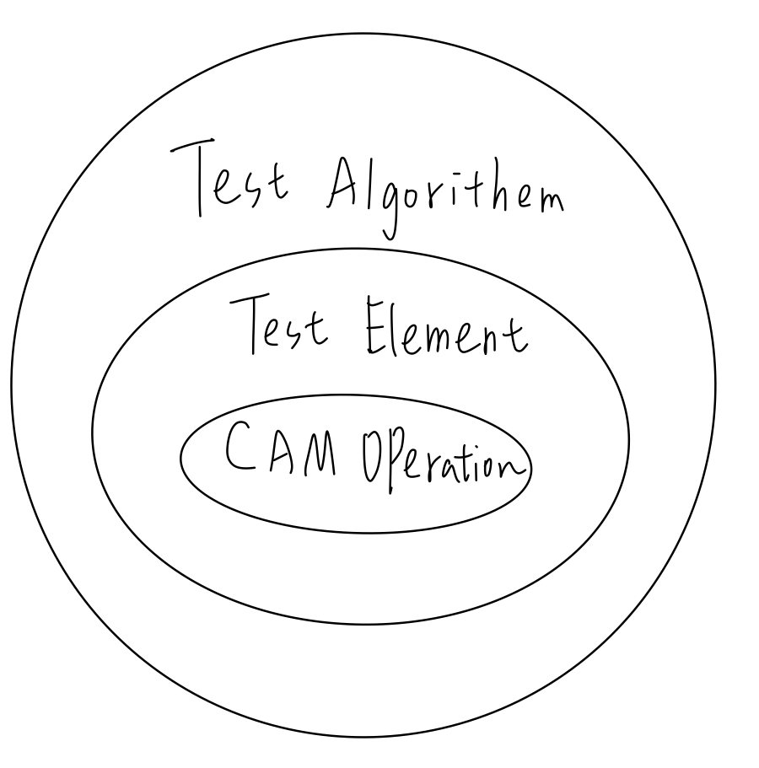



Test Algorithm
Test Element
CAM Operations
Consists of a number of CAM Operations
With a prespecified address sequence
ascending (⇑), descending (⇓)
either way(⇕)
Write an input Pattern D
read an expected data D
given the mask pattern M, compare an input pattern D with all words in the CAM
invalidate the word

Slide 3
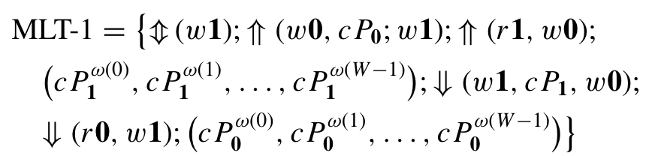
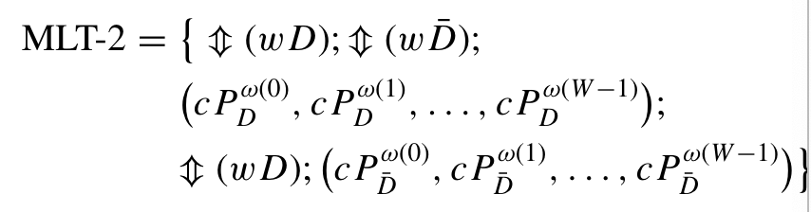

March – Like Test

Slide 4
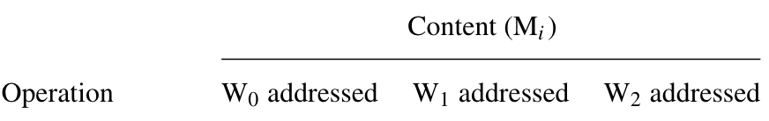
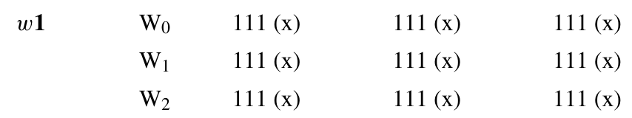
Initializes the CAM array to the all – 1 solid background

Slide 5

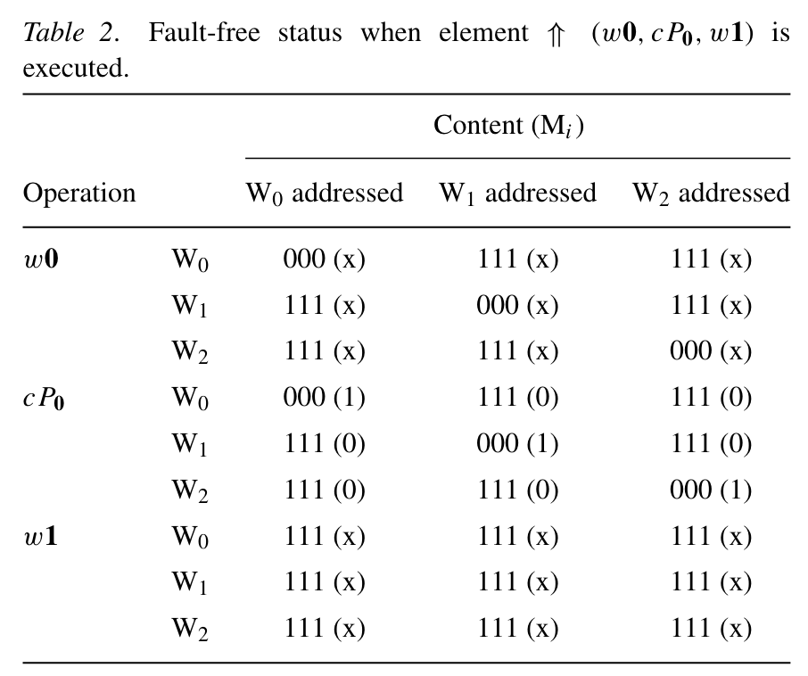
2.
don’t-care (x) state during the Write or Read operation.
The cP0 operation compares the all-0 pattern with the contents of all words
(i.e., W0,W1, and W2) in the CAM concurrently
fault free: M0 = 1, and Hit = 1.
SAF, interword CFs,
SMMF, PMF, EMMF, XMMF, and SIVF
Notes:
whose victims are forced to 1. The aggressors of the CFs undergo the ↑ transition and are located at lower addresses than the victims
SMMF: 永不MM
EMMF: 至少有一個x MM
PMF: 寫入 M
XMMF: 相臨
SIVF: 不參與比較操作
偵測的到這些比較錯誤，因為他們 Mismatch時，Hit = 0

Slide 6

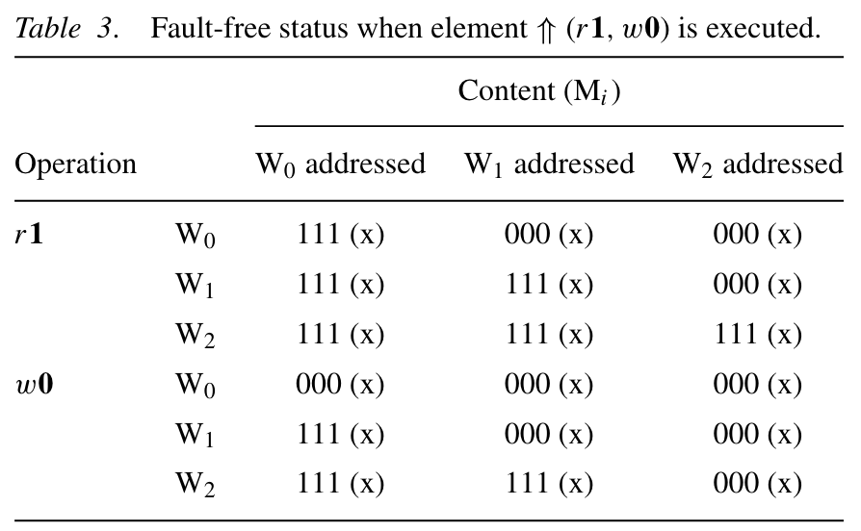
3.
w0 and w1: ↓ and ↑ transitions
r1: inter-word CFid (Aggressors Higher)
w0: ↓ transitions
r1: inter-word CFid (Aggressors Lower)
SAF(0)
inter-word CFst where the aggressors are in state 0 and at lower addresses than the victims or in state 1 and at higher addresses
Notes:
whose victims are forced to 1. The aggressors of the CFs undergo the ↑ transition and are located at lower addresses than the victims
偵測的到這些比較錯誤，因為他們 Mismatch時，Hit = 0

Slide 7

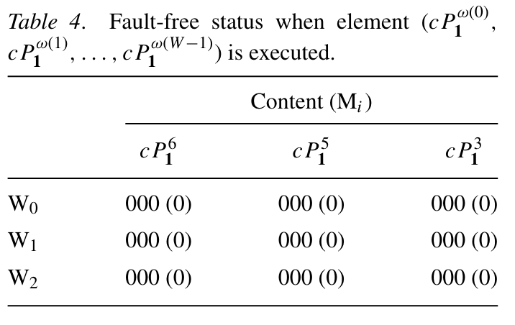
4.
fault-free: Hit = 0, no 1 in that column
SAF(0), SAF(1) and the CF aggressor is 0 or undergoes a ↓ transition to turn the victim into 1.
SMF, CMF, and IMF
Notes:
inequivalence - match fault (IMF) : 如果 CAM 存儲一個 x 並和一個互補輸入值 xbar 做比較，比較操作失敗

Slide 8
MLT-1 Shortcoming
intra-word CFst and CFid are not fully covered by MLT-1, since only the solid (all-0 and all-1) backgrounds are used

Slide 9
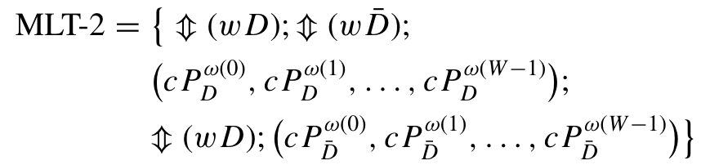

supplied by different data backgrounds
the faulty cell is changed after one of the Write operations
3 and 5 test element (observe)
fault free: Hit = 0

Slide 10
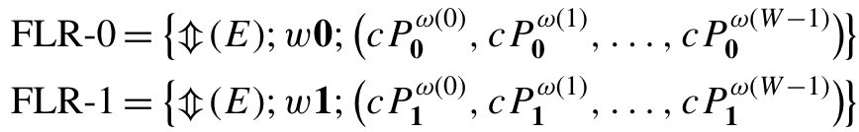
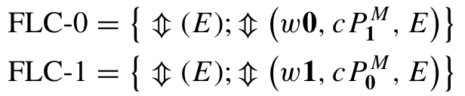
The faulty cells in a word (row)
Diagonostic Algorithms
faulty cells in a column

Slide 11


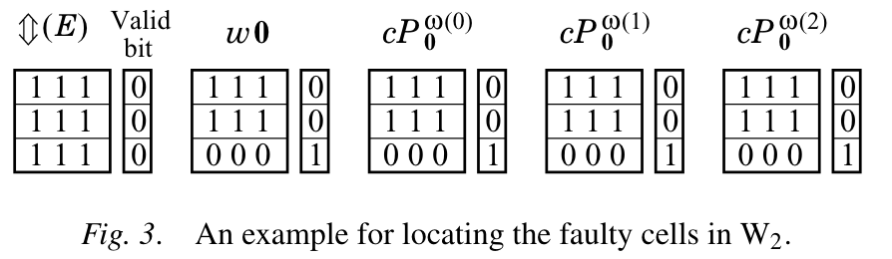
E: first resets all valid bits
w0: sets its valid bit
Note that the w0 operation does not change the state of the faulty cells (victims) since other words are not changed
Fault free: Hit = 1

Slide 12


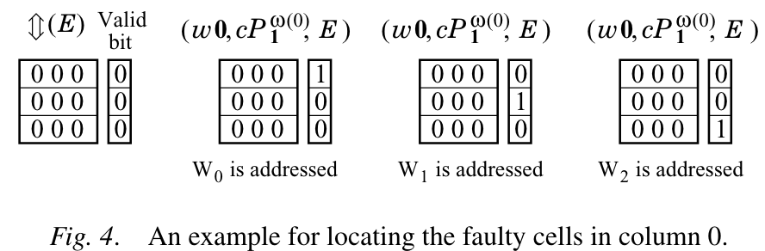
E: first resets all valid bits
w0: write an all-0 patterns words by words
Note that the w0 operation does not change the state of the faulty cells (victims) since other words are not changed
Fault free: Hit = 0

Slide 13
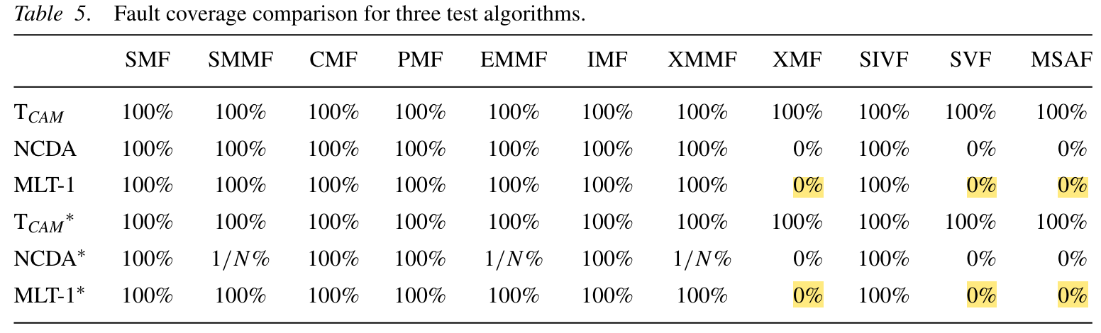
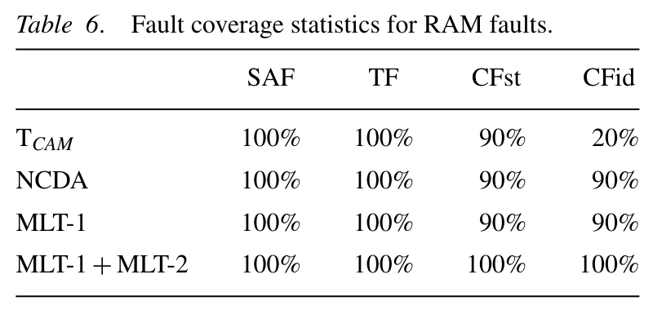
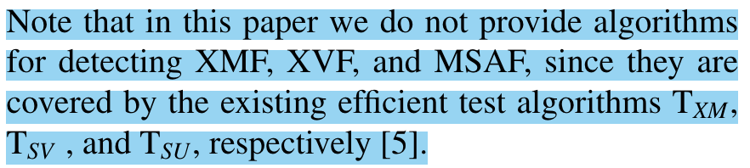

Slide 14
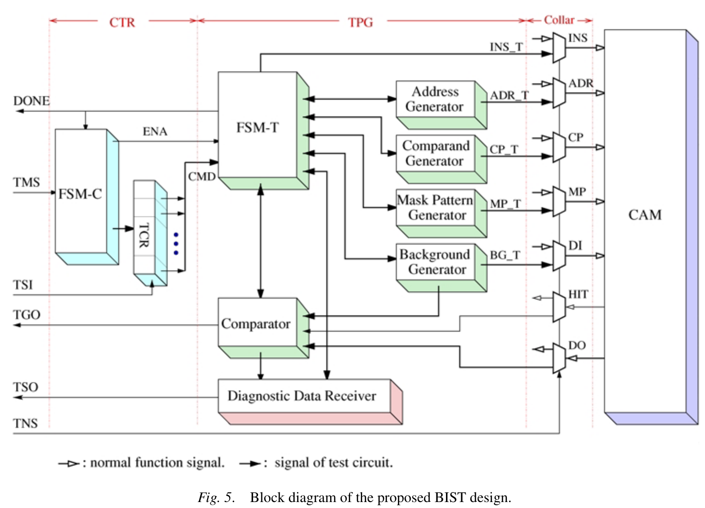
R
W
C
Notes:
如果 bist 電路有有內部演算可覆蓋這些故障，這個硬體很貴。所以可程式化得 CAM BIST 很重要
Controller:像 TPG 發出測試命令，然候產生出的測試命令到 CAM 去處理響應
Test Pattern Generator:包含 background 產生器， 比較氣 和 診斷data接收器，還包含Comparand Generator 和 Mast Pattern產生器
Collar
TXM,TSV , and TSU reported in [5] for detecting XMF, SVF, and MSAF are supported.

Slide 15
Conclusion
high fault coverage and low time complexity
observed only by the Hit output or the priority encoder output.
diagnostic algorithms: positions of the faulty cells
Future: diagnostic algorithms that can also distinguish between different fault types.

